Slide 1
Exp #5 Frame and Tween Animation in Android
SLIDES BY: MOHAMAD BALAWI

Slide 2
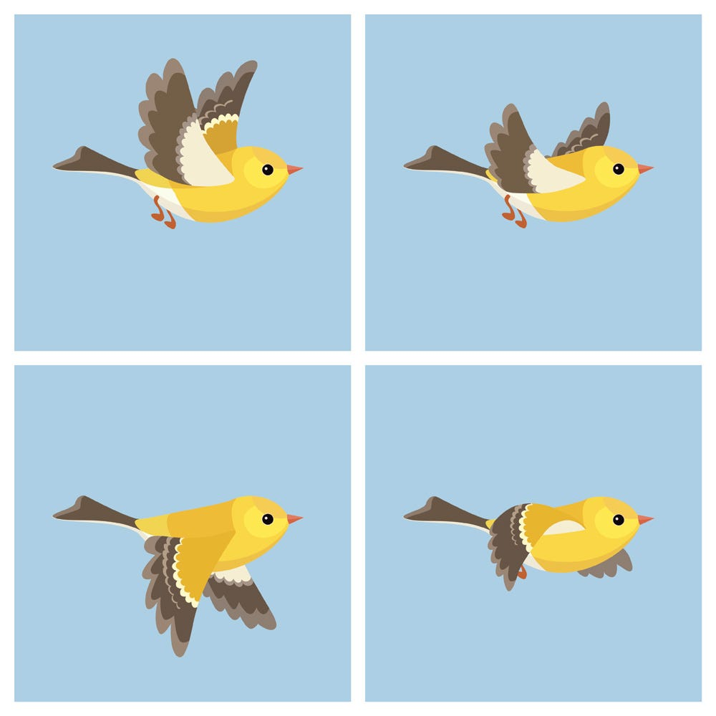
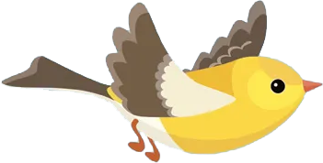
Types of animations in Android
Frame animation
Tween animation
creates an animation by showing a sequence of images in order with an AnimationDrawable.
Simple transformations of position, size, rotation to the content of a View. Animation can be defined in XML that performs transitions such as rotating, fading, moving, and stretching.

Slide 3
Tween animation
AnimationUtils class is used to fetch an animation file from anim folder by using loadAnimation() method of this class which has two arguments (context in which the animation is to be loaded, id of the animation in resources file).
Tween XML attributes:
xmlns:android: Must be defined in the root tag to get the path of the XML file.
android:fromXDelta: Specifies the starting point of translation animation on X-axis.
android:toXDelta: Specifies the ending point of translation animation on X-axis

Slide 4
Tween animation (2)
android:duration: Specifies the duration of the animation in milliseconds.
android:fromXScale: X-axis scale animation starting value (1.0 means no change).
android:toXScale: X-axis scale animation ending value (2.0 means double the size).
android:fromYScale: Y-axis scale animation starting value (0.5 means half the size).
android:toYScale: Y-axis scale animation ending value (1.0 means no change).
android:pivotX: Specifes the X-axis center of rotation/scale.
android:pivotY: Specifes the Y-axis center of rotation/scale.

Slide 5
Tween animation (3)
The values of these XML attributes can be specified using multiple units:
Values from -100 to 100 ending with "%", indicates a percentage relative to the image itself.
Values from -100 to 100 ending in "%p", indicating a percentage relative to its parent.
A float value with no suffix, indicating an absolute value in pixels relative to the image itself.

Slide 6











Tween animation (4)
On the image on the right, the red border represents the image itself, the purple border represents the parent (e.g. Linear layout),
For example, the green dot location is:
$$X=“0\%p”$$
$$Y=“0\%p”$$
$$X=“100\%p”$$
$$Y=“10\%p”$$
$$X=“100\%”$$
$$Y=“100\%”$$
$$X=“50\%p”$$
$$Y=“100\%p”$$
$$X=“100\%p”$$
$$Y=“100\%p”$$
$$X=“100\%”$$
$$Y=“50\%”$$
$$X=“10\%p”$$
$$Y=“10\%p”$$
$$X=“50\%”$$
$$Y=“0\%”$$
$$X=“50\%”$$
$$Y=“50\%”$$
$$X=“10\%p”$$
$$Y=“0\%p”$$
$$X=“0\%”$$
$$Y=“0\%”$$

Slide 7
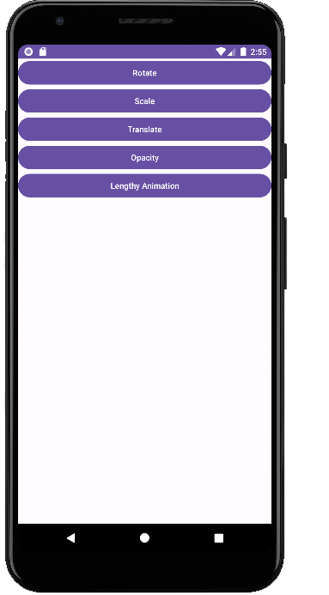
To-Do
Make the bird move like this, and make sure the transitions are 500ms duration.

